Slide 1
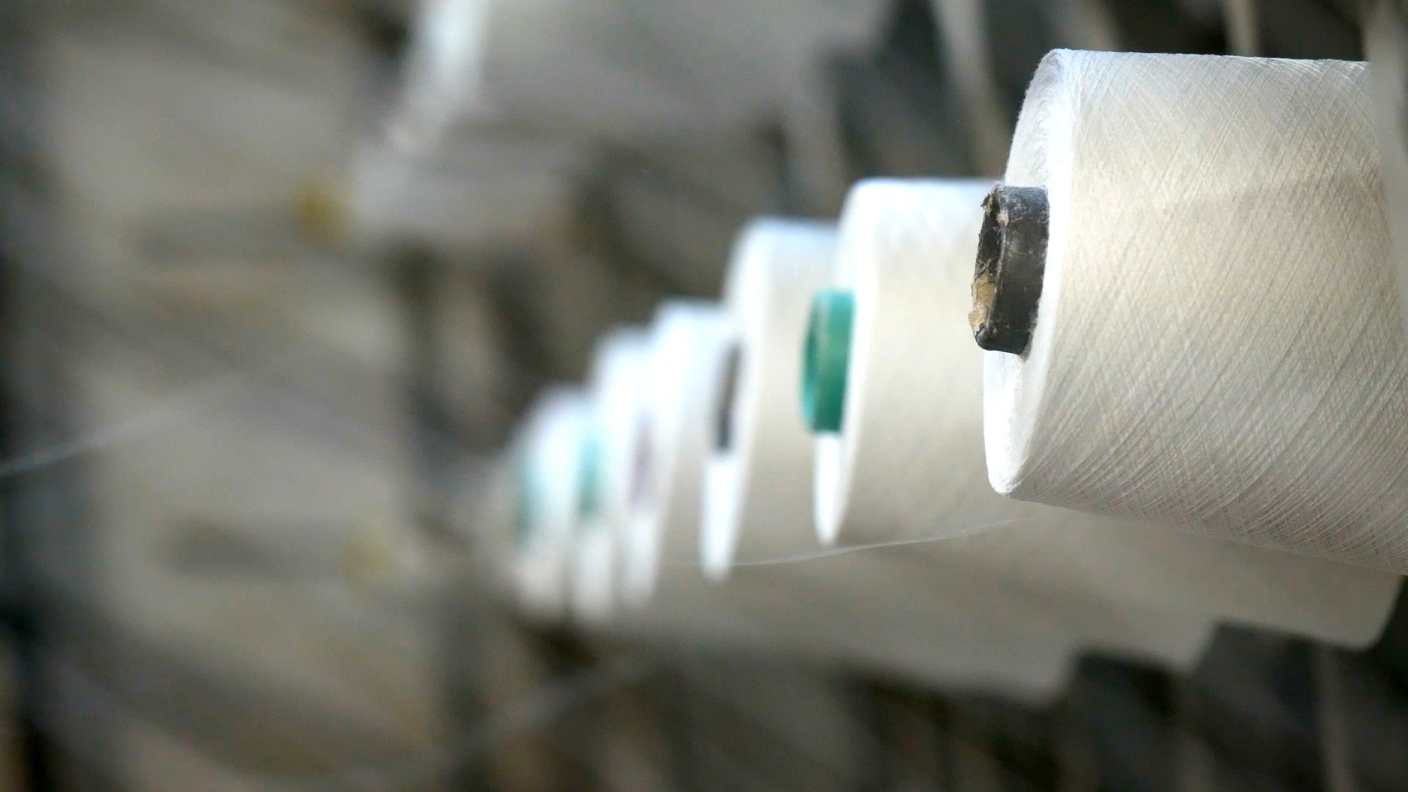
Production of Radioactive Materials
RT4220 – Lecture #7
Kedree Proffitt
WSU
09/23/2025

Slide 2
Why Produce Radionuclides?
Most naturally occurring radionuclides have VERY long-lived half-lives
Heavy elements, not useful for following biological processes
I believe they have low specific activities *source needed

Slide 3
Methods of Production
Reactor-Produced Radionuclides
Fission Products
${}_{Z}^{A}X\left(n, λ\right){}_{Z}^{A+1}X$ reaction
(_Z^A)X (n, 𝜆) (_Z^(A+1))X reaction
${}_{Z}^{A}X\left(n, p\right){}_{Z−1}^{A}Y$ reaction
(_Z^A)X (n, p) (_Z−1^A)Y reaction
Accelerator-Produced Radionuclides
Cyclotron
Synchrocyclotrons
Radionuclide Generators
Moly Cow

Slide 4
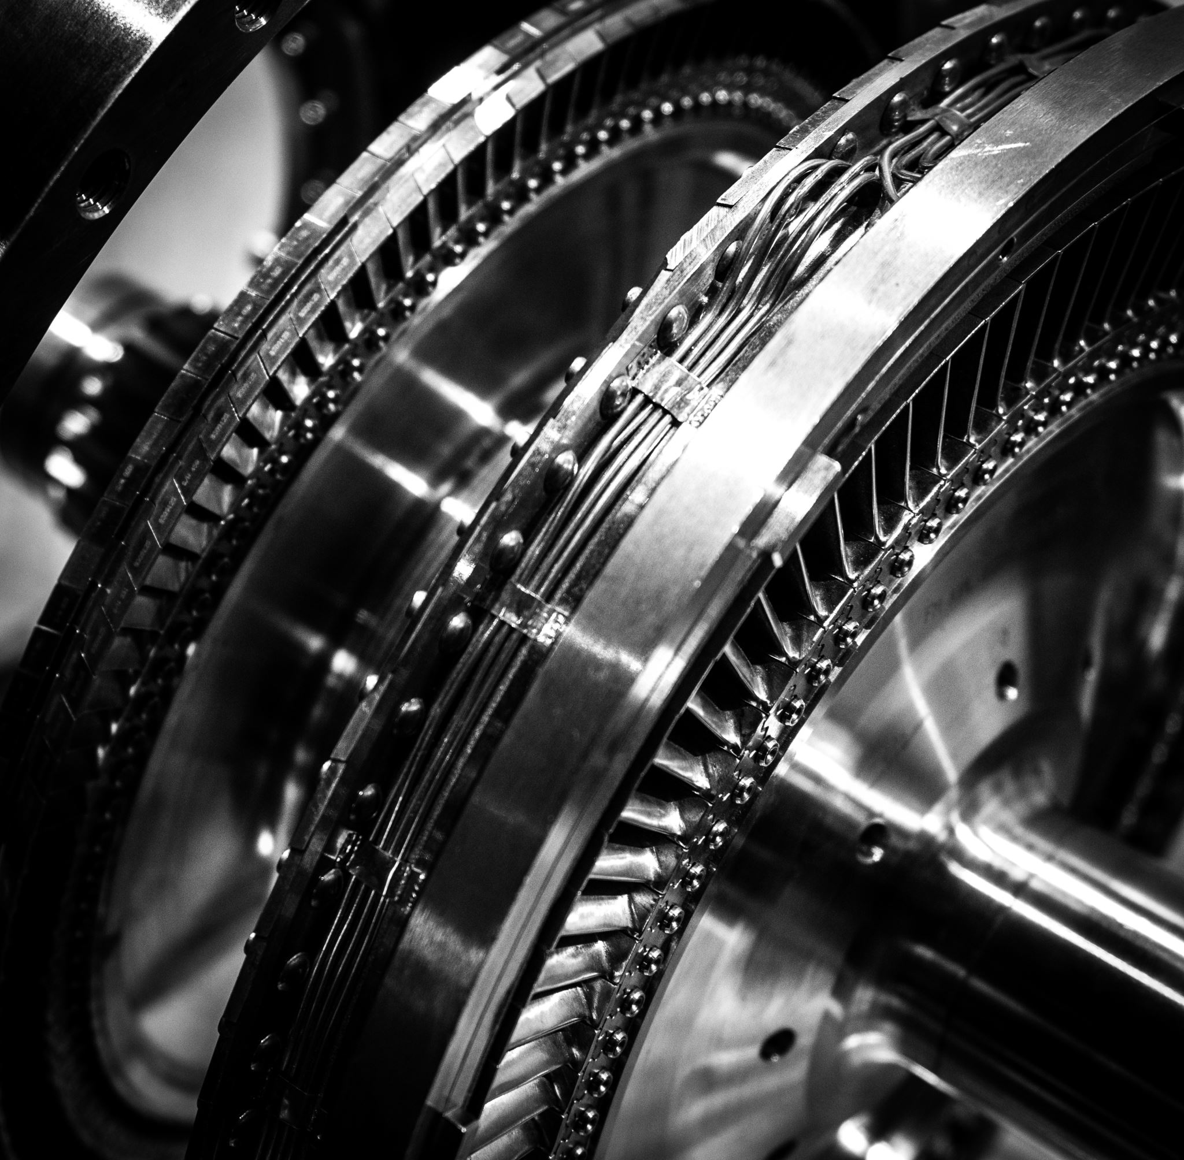

Reactor Produced Radionuclides
“Doh”

Slide 5
Nuclear Reactor Basics
Fission of unstable Uranium → chain reaction of excited states and further fission events → excess energy captured by water → SPIN THAT TURBINE
Neutron excess causes U-235 → U-236 which is even more unstable
Neutrons are neutral charge, interact much less than electrons
Moderators slow down excessively fast neutrons → more likely to react at slower speeds
Heavy water (D2O) or Graphite
Control rods block fuel cells and prevent meltdown
Cadmium or boron

Slide 6
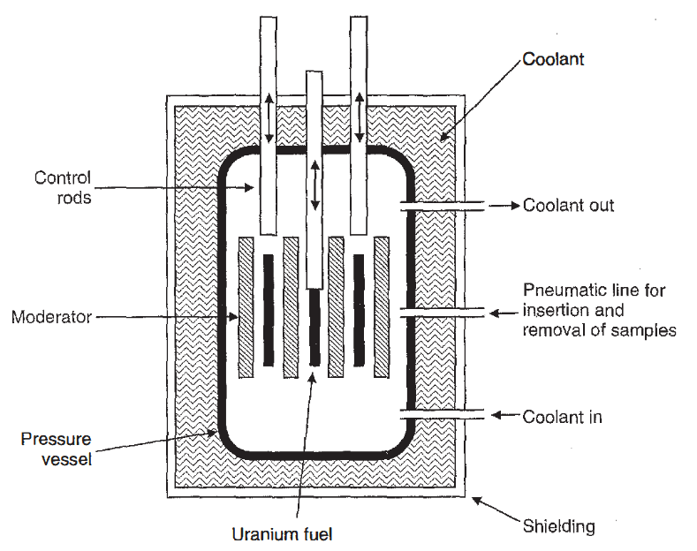
Nuclear Reactor Core Diagram
Schematic representation of a nuclear reactor.

Slide 7
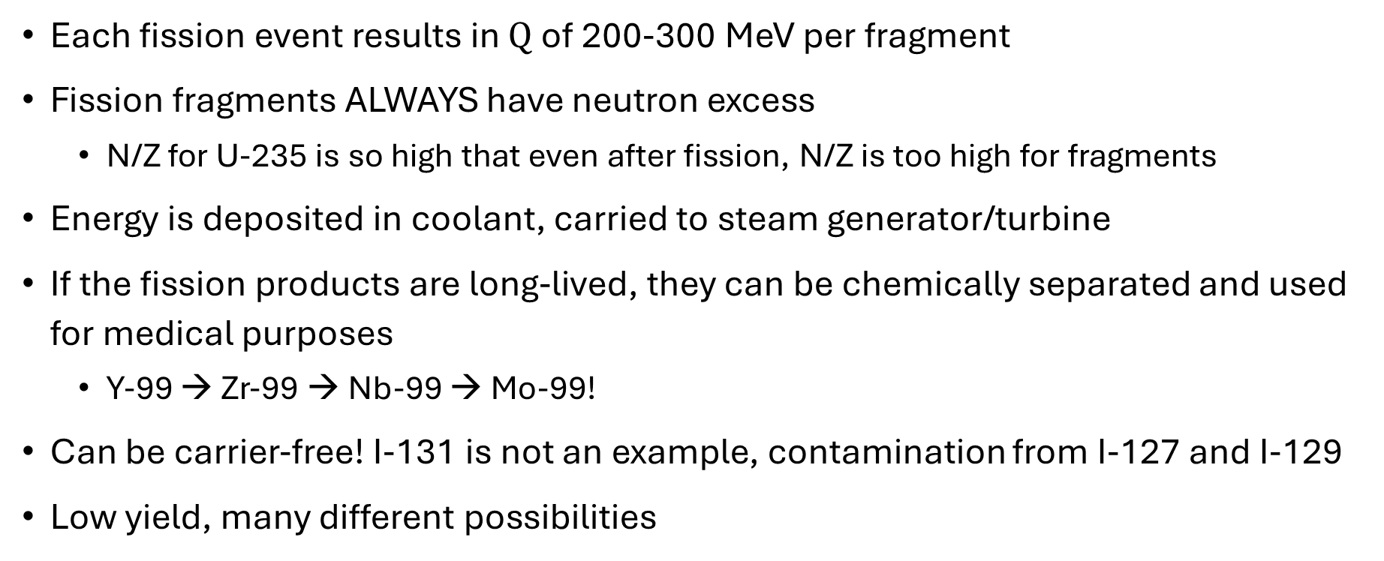
Nuclear Reactor Fission Fragments
Each fission event results in $Q$ of 200-300 MeV per fragment
Fission fragments ALWAYS have neutron excess
N/Z for U-235 is so high that even after fission, N/Z is too high for fragments
Energy is deposited in coolant, carried to steam generator/turbine
If the fission products are long-lived, they can be chemically separated and used for medical purposes
Y-99 → Zr-99 → Nb-99 → Mo-99!
Can be carrier-free! I-131 is not an example, contamination from I-127 and I-129
Low yield, many different possibilities

Slide 8
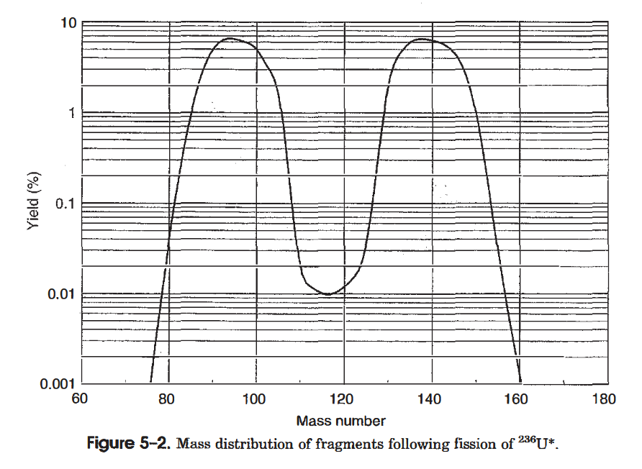
U-236* Fission Fragment Mass Distribution
Equal mass fragments discouraged
85-105 AMU and 130-150 AMU fragments most likely
20 possible elements, over 100 nuclides

Slide 9
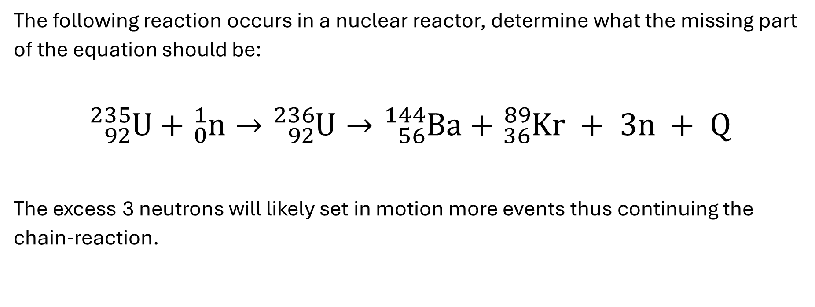
Fission Fragment Practice
The following reaction occurs in a nuclear reactor, determine what the missing part of the equation should be:
$${}_{92}^{235}U+{}_{0}^{1}n→{}_{92}^{236}U→{}_{56}^{144}{Ba}+{}_{36}^{89}{Kr} + 3n + Q$$
The excess 3 neutrons will likely set in motion more events thus continuing the chain-reaction.

Slide 10
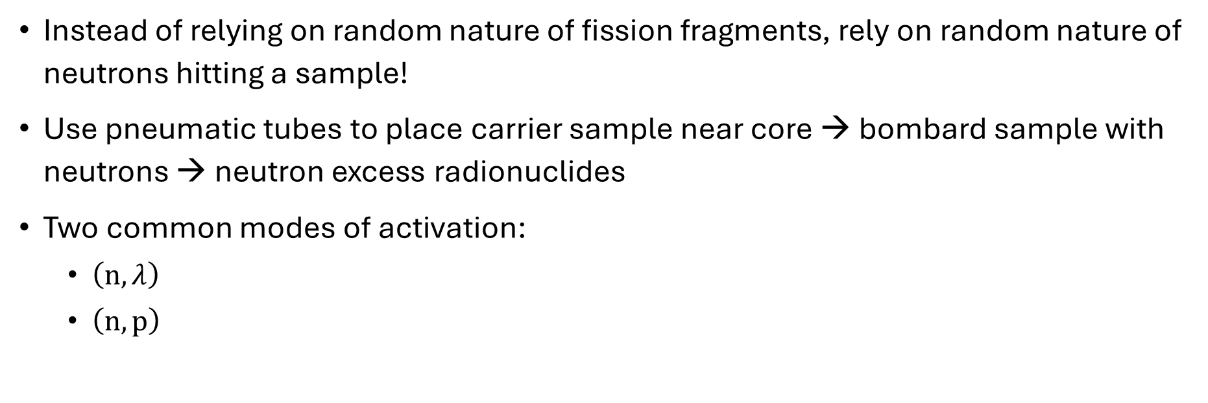
Neutron Activation
Instead of relying on random nature of fission fragments, rely on random nature of neutrons hitting a sample!
Use pneumatic tubes to place carrier sample near core → bombard sample with neutrons → neutron excess radionuclides
Two common modes of activation:
$\left(n, λ\right)$
$\left(n, p\right)$

Slide 11

Neutron Activation: Gamma Reaction
$${}_{Z}^{A}X\left(n, λ\right){}_{Z}^{A+1}X$$
Target nucleus $\left({}_{Z}^{A}X\right)$ captures a neutron $\left(n\right)$
Target nucleus ((_Z^A)X ) captures a neutron (n)
Nucleus forms an excited nuclear state $\left({}_{Z}^{A+1}X\right)$
Nucleus forms an excited nuclear state ((_Z^(A+1))X )
Nucleus emits gamma $\left(λ\right)$
Nucleus emits gamma (𝜆)

Slide 12

Neutron Activation: Proton Reaction
$${}_{Z}^{A}X\left(n, p\right){}_{Z−1}^{A}Y$$
Target nucleus $\left({}_{Z}^{A}X\right)$ captures a neutron $\left(n\right)$
Target nucleus ((_Z^A)X ) captures a neutron (n)
Nucleus ejects a proton $\left(p\right)$
Nucleus ejects a proton (p)
New element is formed $\left({}_{Z−1}^{A}Y\right)$
New element is formed ((_Z−1^A)Y )

Slide 13
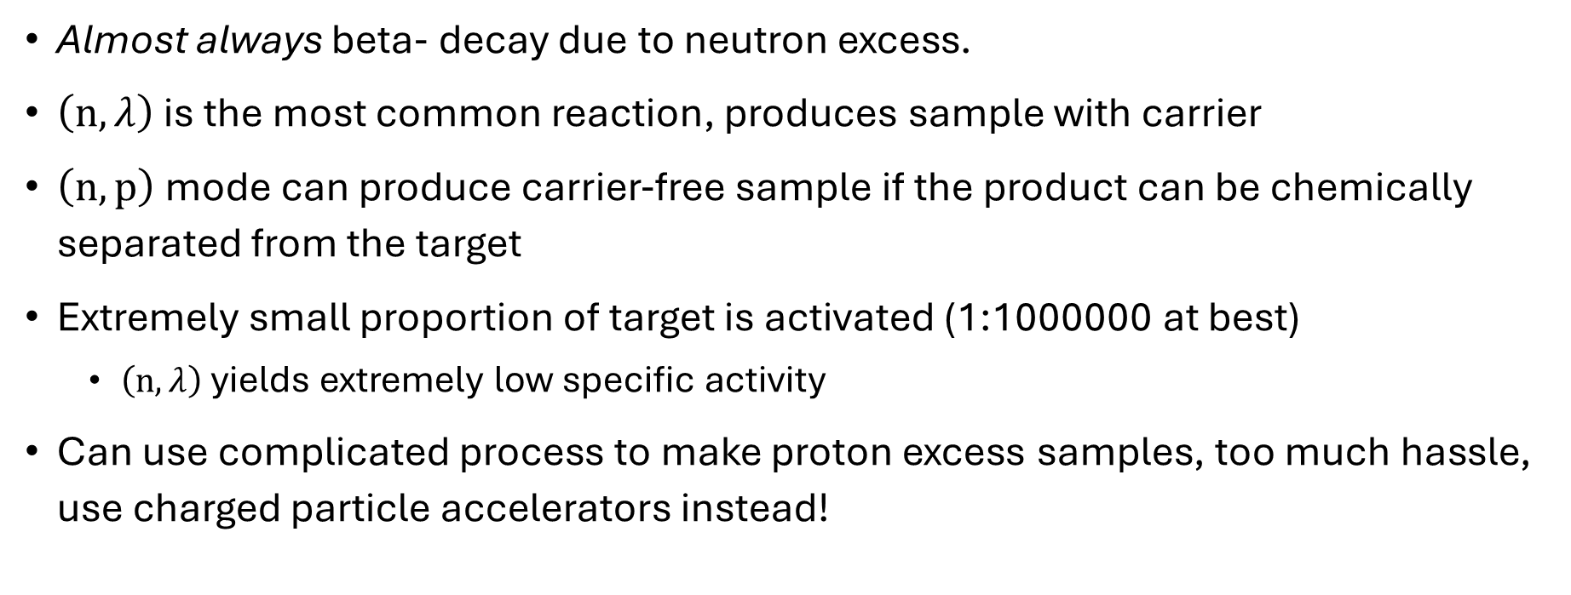
Neutron Activation Characteristics
Almost always beta- decay due to neutron excess.
$\left(n, λ\right)$ is the most common reaction, produces sample with carrier
$\left(n, p\right)$ mode can produce carrier-free sample if the product can be chemically separated from the target
Extremely small proportion of target is activated (1:1000000 at best)
$\left(n, λ\right)$ yields extremely low specific activity
Can use complicated process to make proton excess samples, too much hassle, use charged particle accelerators instead!

Slide 14
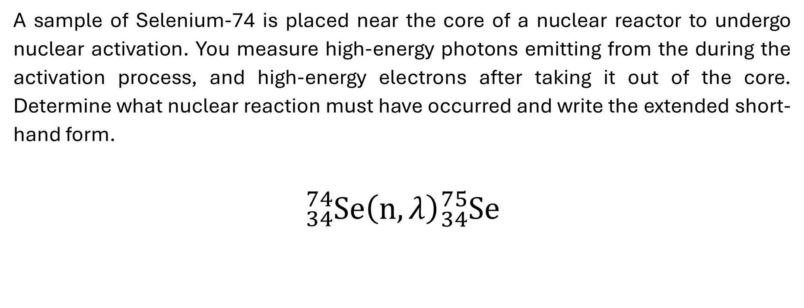
Neutron Activation Practice
A sample of Selenium-74 is placed near the core of a nuclear reactor to undergo nuclear activation. You measure high-energy photons emitting from the during the activation process, and high-energy electrons after taking it out of the core. Determine what nuclear reaction must have occurred and write the extended short-hand form.
$${}_{34}^{74}{Se}\left(n, λ\right){}_{34}^{75}{Se}$$

Slide 15
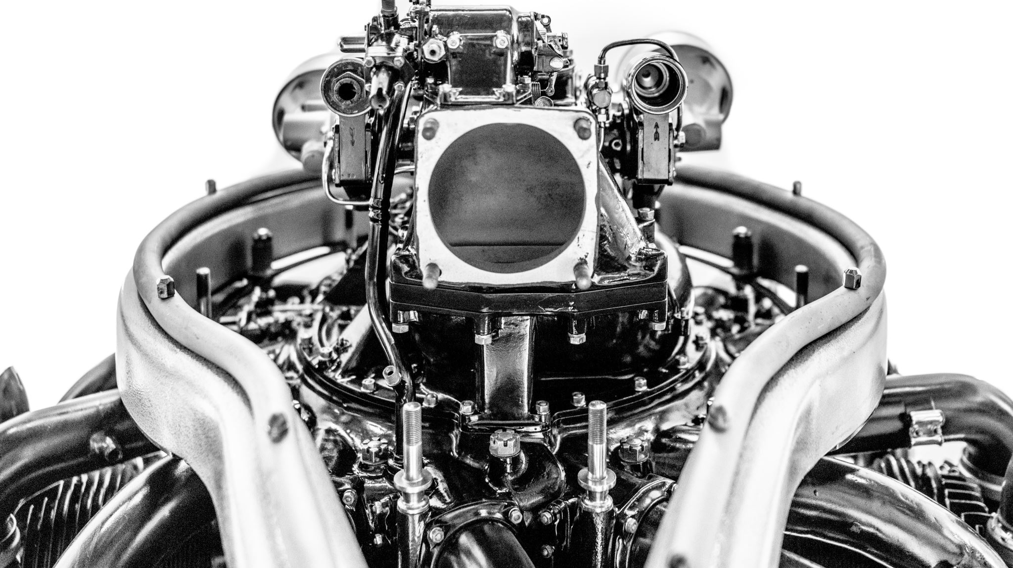
Accelerator Produced Radionuclides
“Dee[z]”

Slide 16
Accelerator Principles
Charged particles must be accelerated to 10-20 MeV to overcome repulsion from nucleus and infiltrate
Differs from thermal neutron capture, where energy must be low!
Easiest way to accelerate charged particles is electric potential (voltage)!
Cyclotron was one of many attempts to create and control high-energy charged particle beams, general design won, many more improvements since then but same basic design

Slide 17
Cyclotron Principles
Hollow “D” shaped electrodes positioned between the poles of a large electromagnet
Narrow gap in the middle
Ion source in the center
Low air pressure
Electric field accelerates ions towards a dee
Dee has no electric field but a strong magnetic field
Charged particle in a magnetic field → acceleration!
When the charged particle reaches the gap it enters electric field, gaining more energy
Each time ions cross gap → more energy → higher speed → greater radius

Slide 18
Cyclotron Principles - Continued
When particles reach maximum energy (20-30 MeV) they reach maximum radius too
Particle is directed to a target inside machine or external target
Positive ion cyclotrons deflect beam directly to target (30% efficient)
Negative ion cyclotrons pass through thin carbon foil which strips the excess electrons, reverses the direction of acceleration towards target (~100% efficient)
Constant acceleration of high energy charged particles requires shielding from photons (negative ion requires less, thus called “cold”, but they require even lower air pressure)

Slide 19
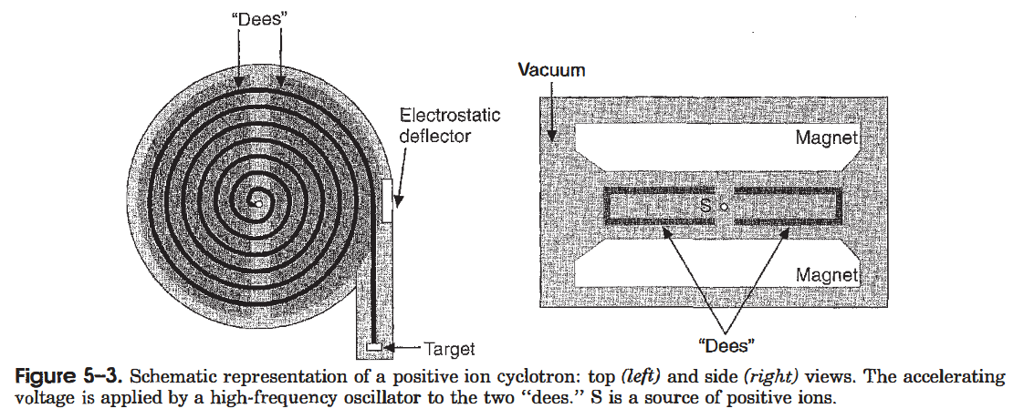
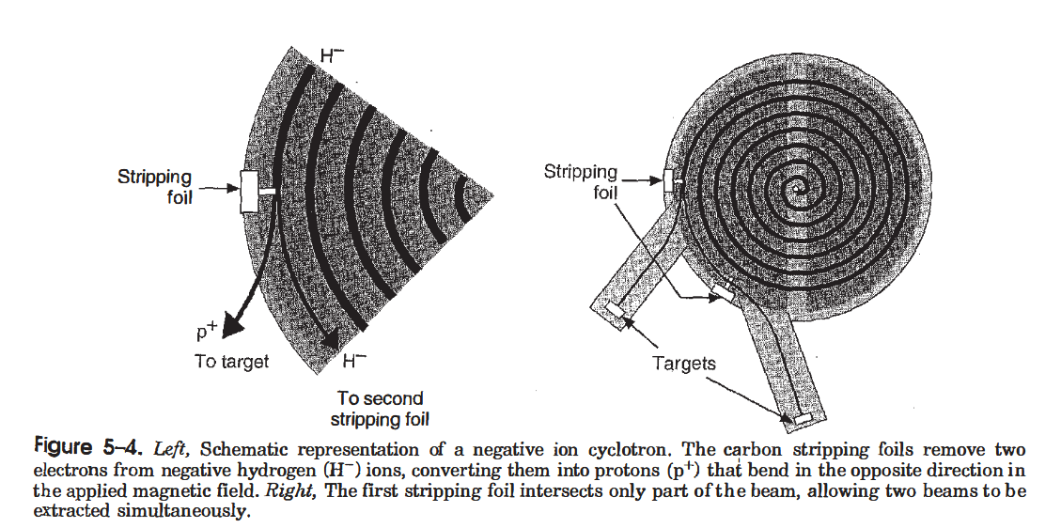

Slide 20
Cyclotron Radionuclide Characteristics
Sample is blasted with positive ions
These radionuclides tend to decay with EC or beta+ (like F-18/FDG!)
Cyclotron-produced products have a different atomic number, if chemically separated it yields carrier-free sample!
Cyclotron-produced radionuclides are typically more expensive than neutron due to lower intensity of beams and even lower activation cross-section
Decay of these emits high-energy photons and positrons → useful for medical imaging (PET!) due to high penetration and low atomic number relevance for biological processes

Slide 21
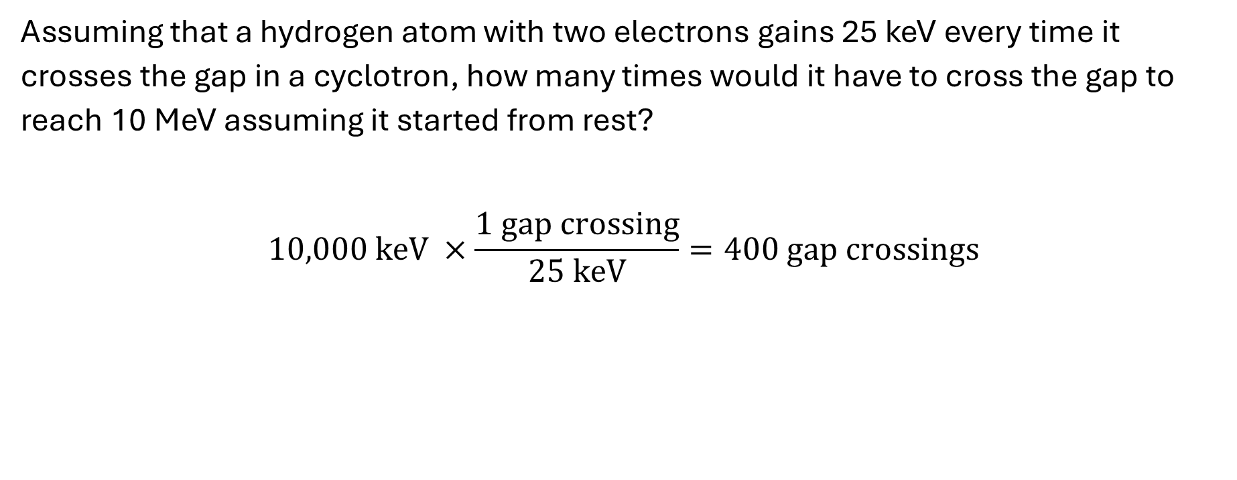
Cyclotron Practice - Energy
Assuming that a hydrogen atom with two electrons gains 25 keV every time it crosses the gap in a cyclotron, how many times would it have to cross the gap to reach 10 MeV assuming it started from rest?
$$10,000 keV ×\frac{1 gap crossing}{25 keV}=400 gap crossings$$

Slide 22
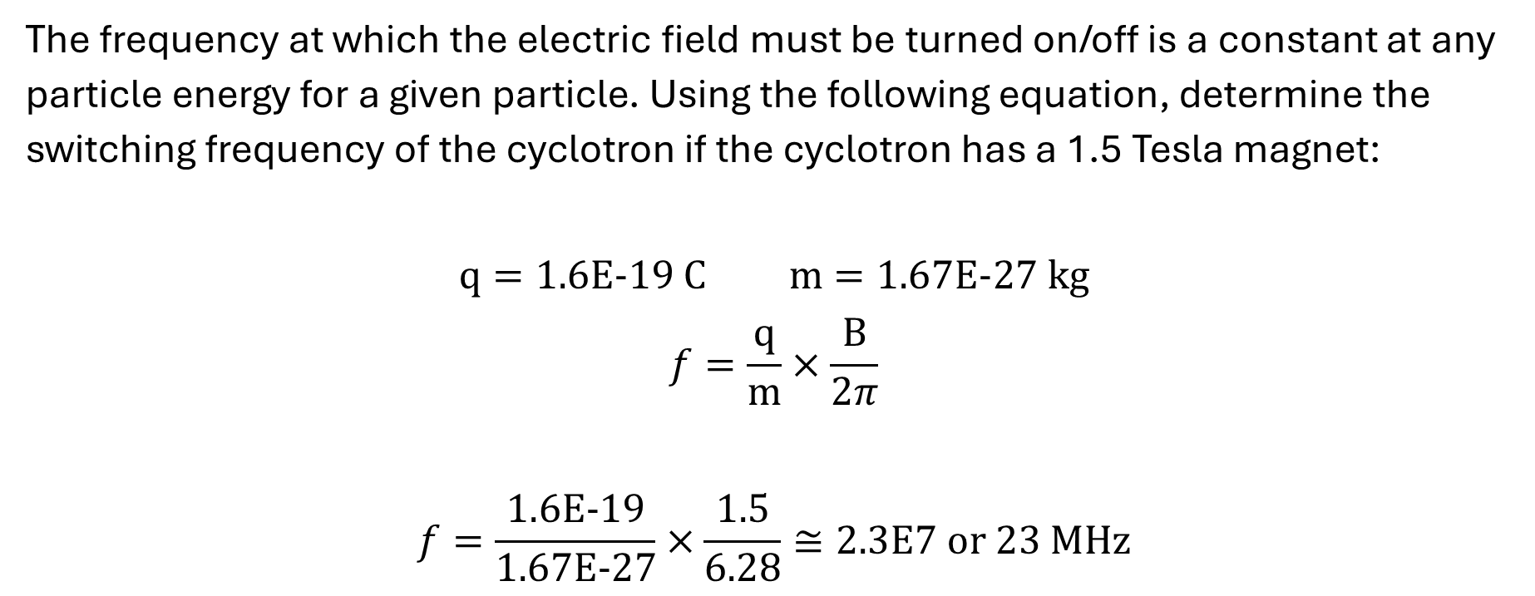
Cyclotron Practice - Frequency
The frequency at which the electric field must be turned on/off is a constant at any particle energy for a given particle. Using the following equation, determine the switching frequency of the cyclotron if the cyclotron has a 1.5 Tesla magnet:
$$q=1.6E−19 C m=1.67E−27 kg$$
$$f=\frac{q}{m}×\frac{B}{2π}$$
$$f=\frac{1.6E−19}{1.67E−27}×\frac{1.5}{6.28}≅2.3E7 or 23 MHz$$

Slide 23
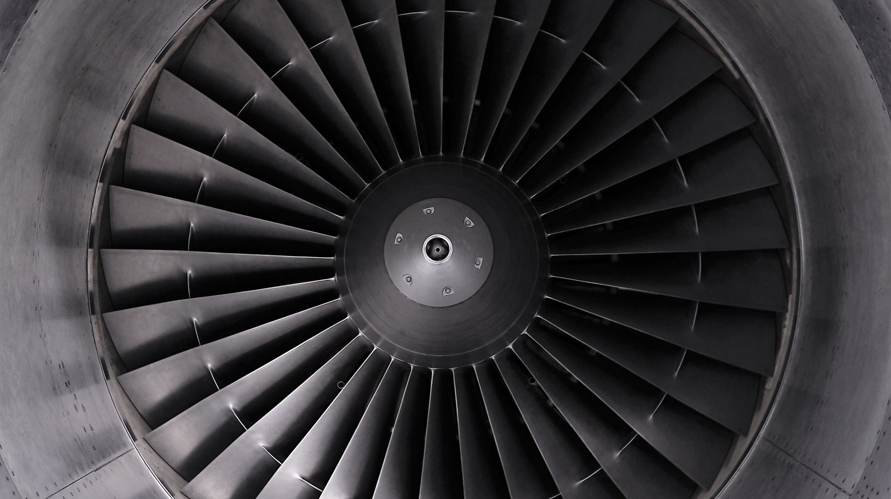
Generator Produced Radionuclides
“Dum?”

Slide 24
Radionuclide Generator Principles
Contains Parent-Daughter pair that permits the extraction of the daughter
Well-shielded and STERILE
Daughter replenishes as parent decays

Slide 25
Technetium Generator (Moly Cow)
Tc-99m decay yields 140 keV photons, low enough to cause minimal damage but high enough to escape the body
Six-hour half-life means the patient can leave safely shortly after the injection
Mo-99 has 67-hour half-life which is just long enough to transport from nuclear reactors to the hospital’s on-site Moly Cow

Slide 26
Moly Cow Terminology
Parent – Mo-99
Daughter – Tc-99m
Core – Area of the generator containing the parent
Elution – The process of separating the daughter from the parent/daughter mixture through washing with a solvent (saline)
Eluant – Solvent which enters the core
Eluate – Solvent which exits the core with the washed away material

Slide 27
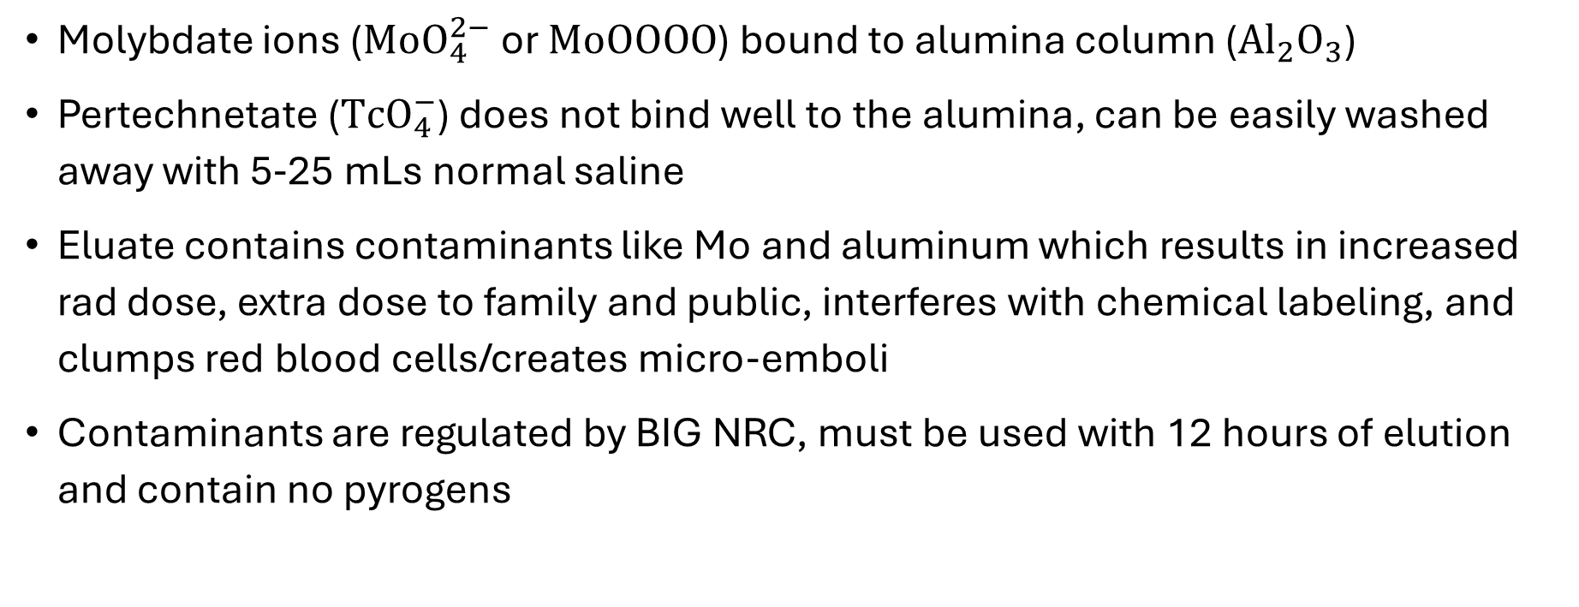
Elution Principles
Molybdate ions ($MoO_{4}^{2−}$ or $MoOOOO$) bound to alumina column ($Al_{2}O_{3}$)
Pertechnetate ($TcO_{4}^{−}$) does not bind well to the alumina, can be easily washed away with 5-25 mLs normal saline
Eluate contains contaminants like Mo and aluminum which results in increased rad dose, extra dose to family and public, interferes with chemical labeling, and clumps red blood cells/creates micro-emboli
Contaminants are regulated by BIG NRC, must be used with 12 hours of elution and contain no pyrogens

Slide 28
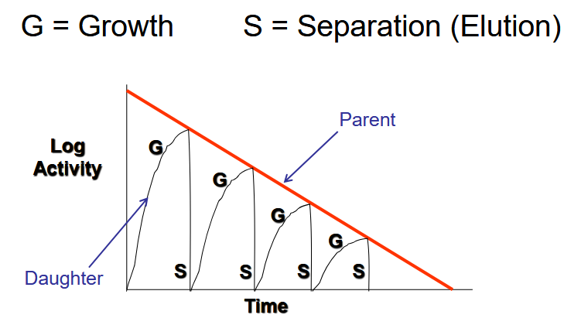
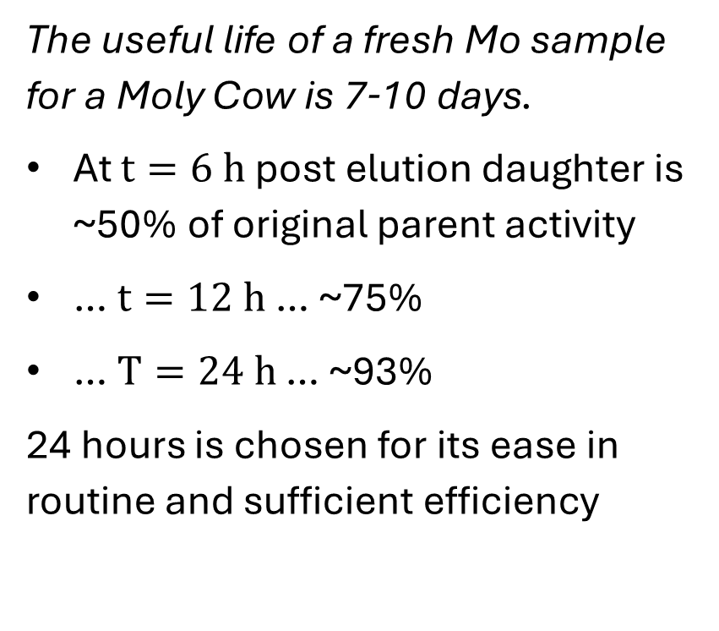
Generator Use-Life
The useful life of a fresh Mo sample for a Moly Cow is 7-10 days.
At $t=6 h$ post elution daughter is ~50% of original parent activity
… $t=12 h$ … ~75%
… $T=24 h$ … ~93%
24 hours is chosen for its ease in routine and sufficient efficiency

Slide 29
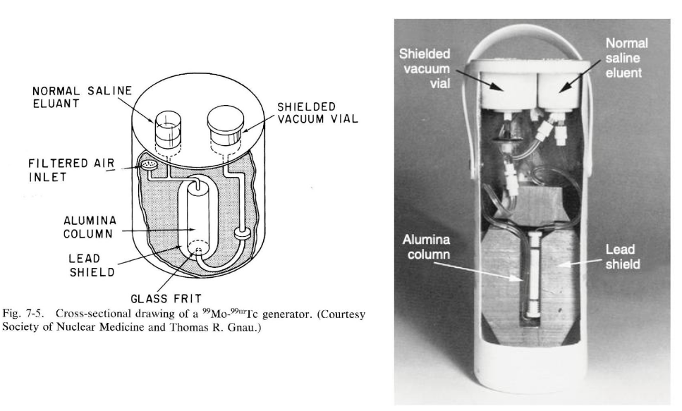

Slide 30
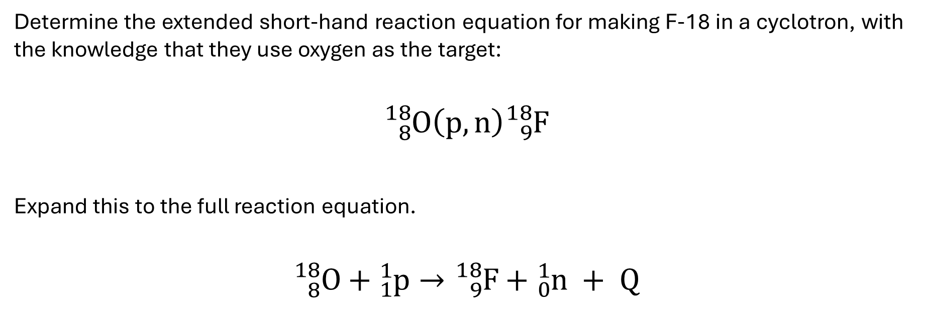
F-18 Practice Calculations 1: Reaction Equations
Determine the extended short-hand reaction equation for making F-18 in a cyclotron, with the knowledge that they use oxygen as the target:
$${}_{8}^{18}O\left(p, n\right){}_{9}^{18}F$$
Expand this to the full reaction equation.
$${}_{8}^{18}O+{}_{1}^{1}p→{}_{9}^{18}F+{}_{0}^{1}n + Q$$

Slide 31
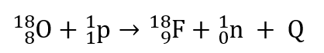
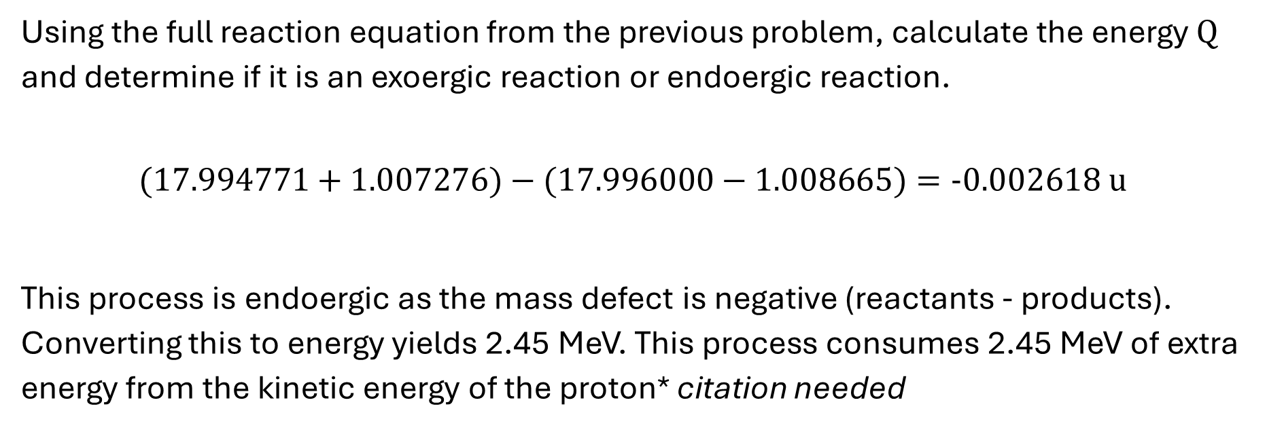
F-18 Practice Calculations 2: Energy Classification
Item | Mass (amu)
O-18 | 17.994771
p | 01.007276
n | 01.008665
F-18 | 17.996000
Using the full reaction equation from the previous problem, calculate the energy $Q$ and determine if it is an exoergic reaction or endoergic reaction.
$$(17.994771+1.007276)−(17.996000−1.008665)=−0.002618 u$$
This process is endoergic as the mass defect is negative (reactants - products). Converting this to energy yields 2.45 MeV. This process consumes 2.45 MeV of extra energy from the kinetic energy of the proton* citation needed
Notes:
Elaborate on nuclide mass vs isotope mass, address the number of electrons on either side and how this can change your answer. I used ChatGPT to triple check my answer and it was wrong because it used atomic mass instead of accounting for the electrons which changed the answer somewhat significantly. I am not sure what happens to that neutron though

